Slide 1


Steve Litster PhD
Global Head of Scientific Computing

Slide 2
NIBR Research Transforming Drug Discovery
Our purpose is to care and cure.
We provide medicines to treat and prevent diseases, ease suffering and improve quality of life.
NIBR Disease Areas
Oncology
Cardiovascular and Metabolism
Infectious Diseases
Ophthalmology
Respiratory Diseases
Gastrointestinal
Musculoskeletal
Notes:
Why is this important: Takes 10 years and 1 billion dollars to produce a drug that gets approved .

Slide 3
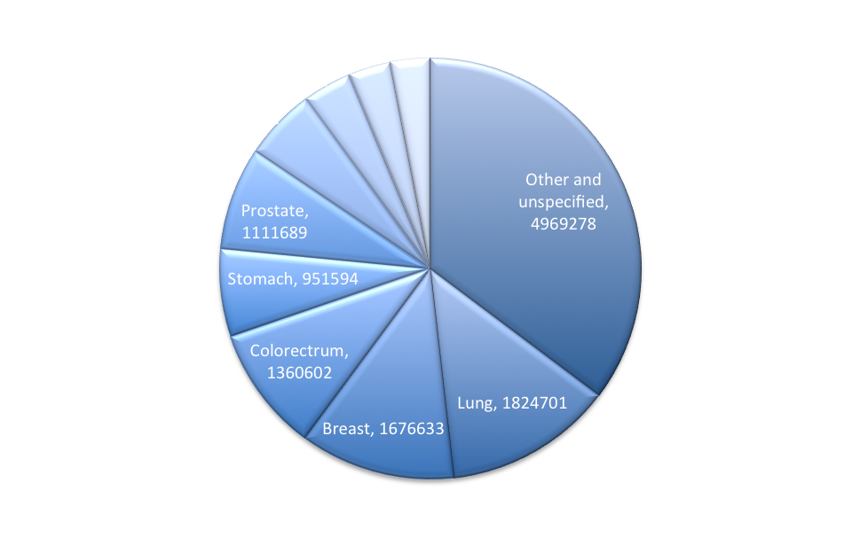
Why And How Can We Have An Impact?
14.1 Million new cases of cancer in 2012
Innovative approaches to Drug Discovery and Patient Care leading to
Shorter Development Times
Safer Treatments
Lower Costs
Drug development: 10 years, $2 billion

Slide 4


Accelerating Scientific Discovery
Challenge: Screen 10 million compounds against common cancer target < 1 Week
Requirements
Virtual Screening
Cost < $10000
Ability to launch/relaunch jobs across multiple AZ’s
Data must be encrypted at rest and “in-flight”
Data must reside as close to the instance as possible
Ability to monitor job progress and costs in real time
Target Molecule
Compound Molecule
Binding Site
“Lock”
“Keys”
Notes:
Mention appprox 14million new cases of cancer in 2012world wide

Slide 5


Architecture Solution
Chef 11 Server
Submits
Jobs & Data
New jobs detected, CycleCloud automatically orchestrates clusters in
4 Availability Zones
Chef continuous instance configuration and ’ app deployment, enables on the fly changes
Singe User Interface
S3
EC2, S3, Route53 APIs for 10,000 instances
*Encrypted Data
*Interactive
Job/Cost Monitoring
Results
Sub-cluster: Condor Schedules subset of
jobs to cluster of EC2 Spot Instances
EBS
*Cloud Optimized Job Scheduler

Slide 6





AWS Delivered Unheard-of Processing
39 years of science
10,600 AWS instances
Saved equivalent of $40M infrastructure
10 million compounds screened
39 drug design years in 11 hours for a cost of … $4,232
3 promising compounds identified

Slide 7

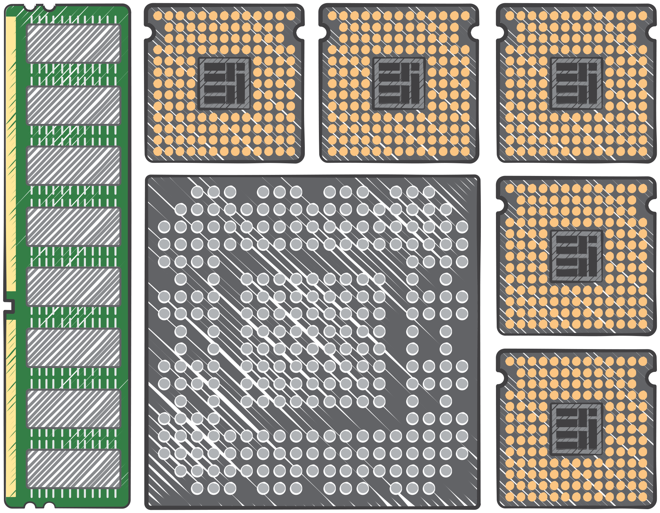

What’s Next for Novartis and AWS
Data Processing & Automation
Data Mining and Informatics
“Traditional” In-Silico
Imaging
Next-Gen Genetic Sequencing
Chemical Universe

Slide 8



Stay in Touch!
“Drug discovery is today’s frontier of science. The interface of the chemical, biological and medical universes is a difficult place to work, worthy of the best minds and most innovative scientists.”
Mark Fishman, President of NIBR
Novartis Institutes for BioMedical Research
@NovartisScience
Discovery Unbound

